Slide 1
Anesthesia for valvular heart disease

Slide 2
Objectives
At the end of this section the student will be able to
Explain the pathophysiology of specific VHD
Identify common cause of VHD
Identify medical and surgical tratment for VHD
Discuss preoperative approach to VHD
Explain choice of anesthetic technique for VHD
Discuss choice of appropriate induction, analgesia and maintenance
Identify major perioperative challenge
Describe post operative management choice

Slide 3
Key 1
CVD is comprise the most prevalent serious disorders in industrialized nations and are a rapidly growing problem in developing nations.
VHD account 2.5% in Industrialized (2014,Jrn.cardiac,lung.B.etal) , while 42 % of cardiac patients in Ethiopia.(2017,Jrn.CVS.medicine.Gemechu.etal.)

Slide 4
Cont….
VHD is becoming more common in our aging population.
An estimate of the prevalence of moderate to severe disease in patients > 75 years old is 13.3%
Rheumatic fever is the dominant cause of VHD in developing and low income countries.

Slide 5
Cont….
Primary VHD ranks well below CAD, stroke, hypertension, obesity, and diabetes as a major threat to the public health.

Slide 6
Cont….
Aside from antibiotic prophylaxis, very little medical therapy is available for patients with VHD.
surgery is the treatment for most symptomatic lesions or for lesions causing left ventricular dysfunction even in the absence of symptoms.

Slide 7
Definition
VHD IS An acquired or congential disorder of a cardiac valve characterized by damage or defect in one of four valves
Pressure overload: mitral & aortic stenosis
Volume overload: mitral & aortic regurgitation
Notes:
Alterations in loading conditions are the initial physiologic burdens imposed by valvular heart lesions, both stenotic and regurgitant. LV is pressure overloaded in aortic stenosis (AS) and volume overloaded in aortic insuficiency and MR.

Slide 8
Cont…
Compensatory mechanisms
Chamber enlargement
myocardial hypertrophy,
variations in vascular tone and level of sympathetic activity.
So what is the consequence ????
Notes:
These mechanisms in turn induce secondary alterations, including altered ventricular compliance,
development of myocardial ischemia, chronic cardiac dysrhythmias, and progressive myocardial dysfunction.
In mitral stenosis, however, the LV is both volume underloaded and pressure underloaded, whereas (RV) faces progressively increasing left atrial and pulmonary
artery pressure.

Slide 9
Cont…
Anesthetic management of Patient with high-risk cardiovascular disease requires:
understanding of cardiac anatomy and pathophysiology
the hemodynamic alterations that may be induced by the choices of analgesic or anesthetic techniques
Notes:
Management in preoperative period require understanding of hemodynamic alteration that accompanies dysfunction of cardiac valve

Slide 10
General preoperative Evaluation of Patients
CVD accounts for the majority of perioperative deaths.
Preoperative detection, investigation, treatment, and risk assessment helps minimize perioperative morbidity and mortality.

Slide 11
Cont…
preoperative evaluation should be primarily concerned with:
Determining the severity of the lesion and its hemodynamic significance
Residual ventricular function
The presence of secondary effects on organ function and Concomitant CAD
Notes:
assess should be evaluated Myocardial ischemia may present in patients with severe aortic stenosis or regurgitation

Slide 12
Cont...
Cardiac complications after non-cardiac surgery depend on
patient-related risk factors
type of surgery
the circumstances under which it takes place
Notes:
the intensity of the preoperative cardiac evaluation must be tailored to the patient’s clinical condition. Appropriate antibiotic prophylaxis reduces the risk of infective endocarditis
and the urgency of the circumstances requiring surgery.

Slide 13
Cont…
some patients with VHD and all patients with a mechanical valve prosthesis require long-term anticoagulation.
Assess for functional reserve of cardiorespiratory
Review Medication (continuation vs discontinuation )
Notes:
3.3. Functional capacity Determination of functional capacity is a pivotal step inpreoperative cardiac risk assessment and is measured in metabolic equivalents (METs)

Slide 14
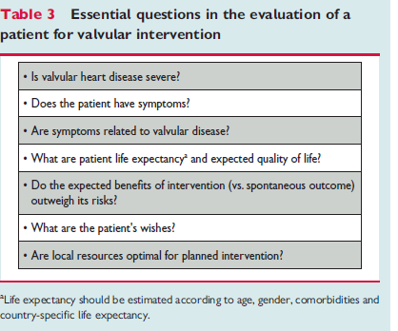

Slide 15
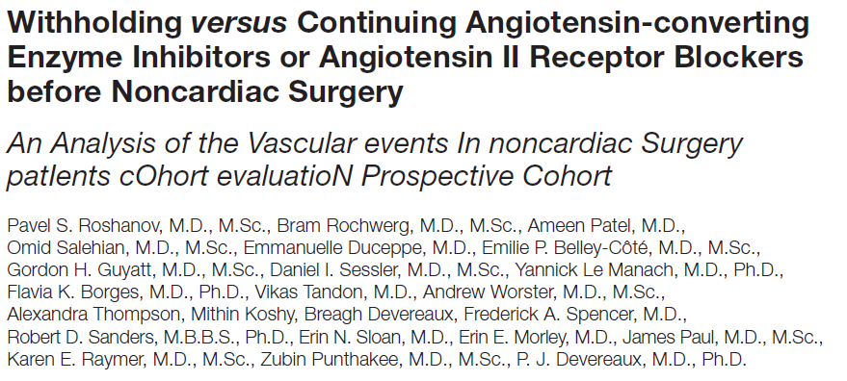

Slide 16
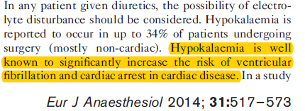
Cont….

Slide 17
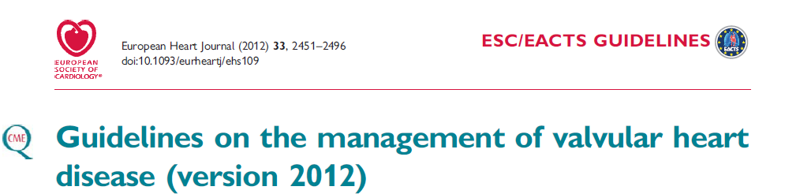
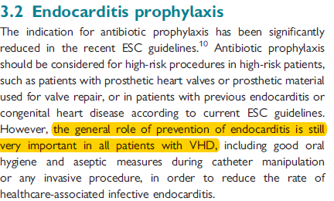

Slide 18
Cont…
Common findings of patients with VHD:
A history of rheumatic fever
IV drug abuse,
exercise intolerance,
fatigability,
May exhibit S/S of CHF
Compensatory increases in SNS tone manifest as resting tachycardia, anxiety, and diaphoresis
Notes:
Should focus on symptoms related to ventricular function:

Slide 19
Cont…
Left –sided heart failure --S 3 gallop or pulmonary rales) and
sustained PMI
Heart murmurs
Notes:
When murmur is there
Determining the cause of cardiac murmurs
Distinguishing between significant murmurs and those that are clinically unimportant

Slide 20
Cont…

Slide 21
Laboratory Evaluation
LFT --- right sided heart failure
ABG– pulmonary edema
Coagulation profile (PTT,PT or INR)- for pts on warfarin or heparin

Slide 22
Investigation
CXR
Cardiomegaly and Calcification of the aortic valve
Post-stenotic dilation of the ascending aorta
ECG
LVH
Pseudoinfarction pattern

Slide 23
Cont…
Echocardiography (LV function)
Trans valvular pressure gradient
Area of the valves and calcification
Ventricular wall thickness and chamber size

Slide 24
^{cont….}
Doppler:
Flow, severity of stenosis
Cardiac catheterization
The measurement of pressures and cardiac output

Slide 25
Intraoperative monitoring
Standard monitoring (ECG, BP, TEMP. ,SPO2 ,ETCO2)
Invasive monitor
Arterial line
CVP
PA Catheter

Slide 26
Aortic stenosis
AS is a fixed outlet obstruction to left ventricular ejection
AS occurs in about one-fourth of all patients with chronic VHD.
Notes:
All valves have trileaflet except mitral-2 cusps. The AV cusps and the corresponding sinuses are named according to their relation to the coronary ostia: Left, right, and noncoronary (opposite the interatrial septum).; causes tremendous resistance to ejectio N which leads to increased left ventricular pressure.
.

Slide 27
Cont…
The AV is composed of three semilunar cusps attached to the wall of the aorta.
The normal AV diameter is 1.9- 2.3 cm with an AV area of 2 - 4 cm2

Slide 28
Cont…
AV Area |  | LV Aortic pressure gradient
mild AS | 1.5–2 cm2. | Mild | 12 – 25 mmHg
moderate | 1–1.5 cm2 | Moderate | 25 - 40 mmHg
severe | <1 cm2 | Significant | 40-50 mmhg
 |  | Critical | > 50 mmHg

Slide 29
Cont…
The increased perioperative risk during noncardiac surgery in patients with severe AS face a 17.3% risk of cardiac complications and a 13% mortality rate during noncardiac surgery. ( 2007,Stewart et al and Lindroos et al 2003)
In a retrospective cohort perioperative mortality and nonfatal myocardial infarction was more common in patients with aortic stenosis than in those without it (14% vs 2%,respectively).(Kertai MD et al. 2004, Pub med )

Slide 30
ETIOLOGY AND PATHOGENESIS
Etiology:
degenerative and calcification of the aortic cusps (in adult)
congenital (bicuspid aortic valve( most common ),unicuspid )
chronic (trileaflet) deterioration
previous rheumatic inflammation.

Slide 31
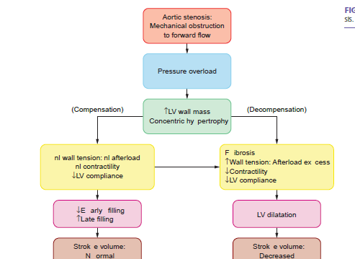
PATHOPHYSIOLOGY
Notes:
A large transaortic valve pressure gradient may exist for many years without a reduction in cardiac output (CO) or LV dilation; ultimately,
however, excessive hypertrophy becomes maladaptive, LV systolic function declines because of afterload mismatch, abnormalities of diastolicfunction progress, and irreversible myocardial fibrosis develops.

Slide 32
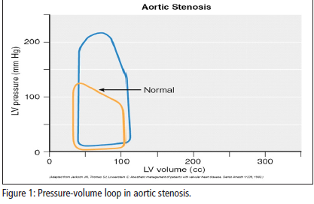
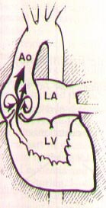
Cont…

Slide 33
Cont…
The classic symptoms of AS
angina (35%), syncope (15%), and exertional dyspnea (50%)
CHF.
Notes:
should suggest the possibility of associated mitral valve disease.

Slide 34
Cont….
Physical findings:
thrill or anacrotic “shudder” may be palpable over the carotid arteries
ejection (mid) systolic murmur(most commonly 2nd ICS)

Slide 35
LABORATORY EXAMINATION
Baseline investigation(CBC, organ function test )
ECG-(LV hypertrophy, ST segment depresion, T wave)
C-X-Ray
Catheterization –special when a discrepancy between the clinical and noninvasive findings
Notes:
Catheterization -Right and left heart catheterization for invasive assessment of AS is performed infrequently but can be useful when there is a discrepancy between the clinical and noninvasive findings

Slide 36
Cont…
echocardiography
identifying coexisting valvular abnormalities
differentiating valvular AS from other forms of LV outflow obstruction
for measurement of the aortic root and proximal ascending aortic dimensions.

Slide 37
TREATMENT
MEDICAL
avoided strenuous physical activity and competitive sports
beta blockers and angiotensin-converting enzye (ACE) inhibitors and Nitroglycerin
Notes:
beta blockers and angiotensin-converting enzye (ACE) inhibitors - for asymptomatic patients with preserved LV systolic function. Nitroglycerin -relieving angina pectoris in patients with CAD.

Slide 38
Cont….
SURGERY- percutaneous balloon valvulotomy or aortic replacement
severe AS area <1 cm2 or 0.6 cm2/m2 BSA,
who are symptomatic,
LV systolic dysfunction (EF <50%),
BAV disease and an aneurysmal root or ascending aorta (maximal dimension >5.5 cm).

Slide 39
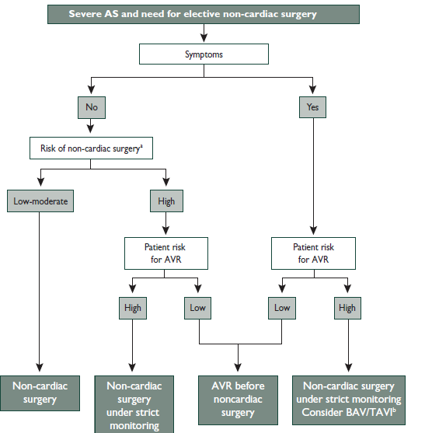
Anesthesia consideration for AS

Slide 40
Anesthetic Considerations
Hemodynamic Goal
Preload- full, adequate IVV to fill noncompliant ventricle
Afterload - already elevated but relatively fixed, CPP must be maintained
Contractility- usually not a problem, inotropes may be helpful preinduction in end-stage AS with hypotension

Slide 41
Cont….
Rate – (60-80), not too slow (decrease CO), not too fast (ischemia)
Rhythm - Sinus!! Cardioversion if hemodynamic instability from SV dysrhythmias
MVO₂ - Ischemia is an ever present risk, Avoid tachycardia and hypotension
Notes:
Coronary perfusion pressure must be maintained to prevent the vicious cycle of hypotension-induced ischemia, subsequent ventricular dysfunction,and worsening hypotension.

Slide 42
Anesthesia managements for AS
Anything interfering with atrial function ( junctional rhythm or atrial fibrillation) can lead to severe hypotension.
avoid either tachycardia or bradycardia and hypotension
Maintain preload and contractility
Notes:
treat any possible arrhythmia, external cardioversion pads should be considered, preferably before induction of anesthesia.

Slide 43
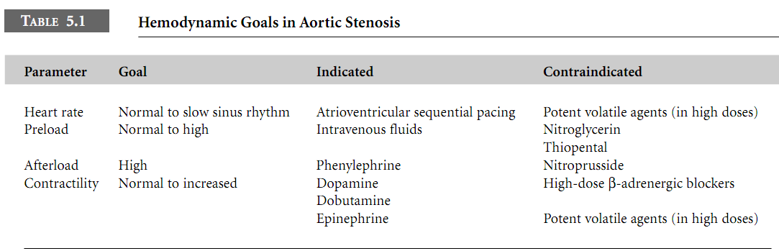

Slide 44
Choice of anesthesia
Measure Operative risk
avoiding fluctuations in the patient’s hemodynamics, while achieving adequate anesthetic depth.
Regional vs GA
Notes:
Due to diastolic dysfunction and impaired relaxation, the “atrial kick” may contribute as much as 40% of the total cardiac output’’’’’'Measure Operative risk depends upon the severity of the AS, whether the patient has concomitant coronary disease, and the risks of the surgical procedure

Slide 45
Aortic regurgitation
AR is the flow of blood from the aorta backwards into the LV during the diastolic phase of the cardiac cycle.
Is the result of annular dilatation or structural AV cusp lesions.
Notes:
Prolapse of an aortic cusp, resulting in progressive chronic AR,

Slide 46
Etiology
Primary valve disease
Congenital (bicuspid)
Endocarditis
Rheumatic fever
Myxomatous (prolapse)
Traumatic
Syphilis
Ankylosing spondylitis
Root disease
Aortic dissection
Cystic medial degeneration
Marfan’s syndrome
Bicuspid aortic valve

Slide 47
PATHOPHYSIOLOGY
The total stroke volume ejected by the LV is increased in patients with AR.
In patients with severe AR, the volume of regurgitant flow may equal the effective forward stroke volume.
Notes:
(TSV i.e., the sum of the effective forward stroke volume and the volume of blood that regurgitates back into the LV). The dilation and eccentric hypertrophy of the LV allow this chamber to eject a larger stroke volume without requiring any increase in the relative shortening of each myofibril.

Slide 48
major hemodynamic compensation for AR
increase in the LV end-diastolic volume
The dilation and eccentric hypertrophy of the LV

Slide 49
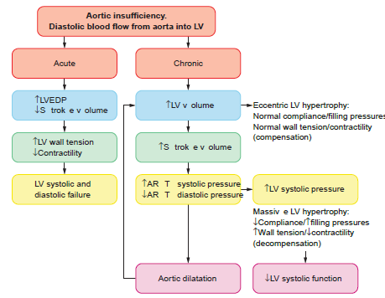
Pathophysiology
Notes:
severe AR may occur with a normal effective forward stroke volume and a normal LVEF (total [forward plus regurgitant] stroke volume/end-diastolic volume), together with an elevated LV end-diastolic pressure and volume. Chronic AR is more prevalent and carries a much better prognosis than acute AR.

Slide 50
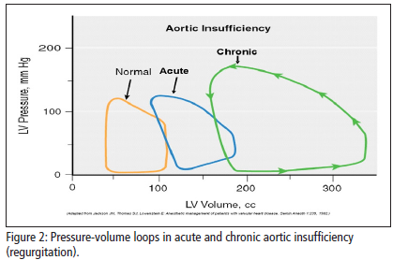
Cont….
Notes:
Progressive volume loading in chronic AR increases end-diastolic wall tension. The left ventricle undergoes a process of remodeling due to series replication of sarcomeres and myofibril elongation, with development of eccentric ventricular hypertrophy and chamber enlargement. shows that the pressure-volume loop is shifted far to the right in patients with chronic AR.

Slide 51
CONT….
Characterized by:
Chronic volume overload
Eccentric hypertrophy
Forward stroke volume higher than normal causing increased systolic pressure
Regurgitation across the valve causes diastolic pressure to be lower than normal
Notes:
N.B. In patients with AR, forward flow is improved by peripheral vasodilation.

Slide 52
Cont….
acute AR causes an acute increase in the volume coming into the left ventricle.
the regurgitant volume depends
diastolic time interval
the diastolic pressure gradient across the valve
the regurgitant orifice area

Slide 53
Cont…
Degree of AR based on regurgitant volume
< 20% of the total left ventricular stroke volume is considered mild,
20%-39% - moderate
40%-60% -moderately severe,
> 60% -severe

Slide 54
Signs and symptoms
Patients may be asymptomatic for as long as 20 years; initial symptoms are:
exertional dyspnea
orthopnea
paroxysmal nocturnal dyspnea
Notes:
Notably, (LVEDP) remains relatively normal because (LVEDV) increases slowly that is why remain asymptomatic

Slide 55
Cont…
Acute aortic regurgitation reflects cardiovascular collapse and patients present with:
severe dyspnea
hypotension, and weakness
Notes:
A rapidly rising “, which collapses suddenly as arterial pressure falls rapidly during late systole and diastole (Corrigan’s pulse), and capillary pulsations, an alternate flushing and paling of the skin at the root of the nail while pressure is applied to the tip of the nail (Quincke’s pulse), are characteristic

Slide 56
Cont…
Chronic aortic regurgitation exhibits:
diastolic murmur , decreased diastolic pressure, water-hammer” pulse
widened pulse pressure, bounding peripheral pulses

Slide 57
LABORATORY EXAMINATION
ECG
C-X ray
Echo- determining the cause of AR, by detecting dilation of the aortic annulus and root
Cardiac catatherization
Notes:
ECG –signs of LV hypertrophy ST-segment depression and T-wave inversion in( I, aVL, V5, and V6 (“LV strain”).

Slide 58
Treatment of AR
intravenous diuretics and vasodilators.
It is often difficult to achieve adequate control because of the increased stroke volume that accompanies severe AR.
Surgical intervention.
Cardiac arrhythmias and systemic infections are poorly tolerated in patients with severe AR and must be treated promptly and vigorously.
Notes:
Beta blockers are also best avoided so as not to reduce the CO further or slow the heart rate, thus allowing more time for diastolic filling of the LV. Systolic blood pressure should be controlled (goal <140 mmHg) in patients with chronic AR, and vasodilators are an excellent first choice as antihypertensive agents.

Slide 59
Anesthesia consideration
Hemodynamic goal
P – normal, avoid hypervolemia
A - Reduce
C - usually adequate
R - Modest tachycardia(80-100) -reduces ventricular volume, raises aortic diastolic pressure

Slide 60
Anesthesia management
The main goal is to avoid further increases in LV wall stress.
mildly vasodilated, and modestly tachycardic described
Keep SVR low
Avoid myocardial depression
Give prophylactic antibiotics
Notes:
[SVR]) will minimize the pressure gradient back across the aortic valve during diastole, improving forward flow and decreasing LVEDP

Slide 61
Choice of anesthesia
Most patients will tolerate spinal or epidural, provided intravascular volume is maintained.
Monitoring should be aimed at detecting arrhythmias and myocardial ischemia
Severe AR may necessitate monitoring with a PA catheter or TEE

Slide 62
Postoperative management
Deep vs awake
Pain management
Fluid management
O2 support
Positioning
Hemodynamic goal should be achieved

Slide 63


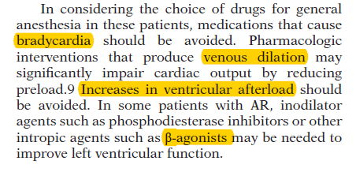

Slide 64
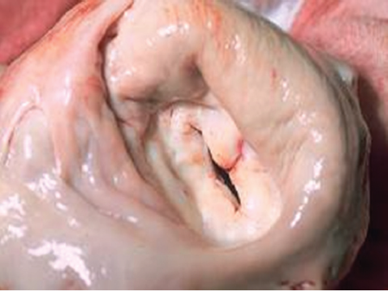
Mitral stenosis
MS is characterized by mechanical obstruction to left ventricular diastolic filling secondary to a progressive decrease in the orifice at the mitral valve
Notes:
Rheumatic heart disease was once the primary cause of mitral stenosis (MS),

Slide 65
Mitral stenosis
ETIOLOGY
Rheumatic fever
congenital mitral valve stenosis
mitral annular calcification
Systemic lupus erythematosus,
rheumatoid arthritis and left atrial myxoma
Notes:
66% of patients are female

Slide 66
Pathophysiology
In normal adults, the area of the mitral valve orifice is 4–6 cm2.
The orifice area is reduced to < ~2 cm2, In the presence of significant obstruction blood can flow from the LA to LV only if propelled by an abnormally elevated left atrioventricular pressure gradient.

Slide 67
Cont…
Severe MS ( <1 cm2) -LA pressure of ~25 mmHg is required to maintain a normal CO.
The elevated pulmonary venous and pulmonary arterial wedge pressures reduce pulmonary compliance, contributing to exertional dyspnea.

Slide 68
Cont…
Mitral valve orifice size
Normal: 4 - 6 cm²
Mildly stenotic: 1.5 - 2.5 cm²
Moderately stenotic: 1.1 - 1.5 cm²
Severely stenotic: < 1 cm²
Usually have symptoms when area is decreased by 50%

Slide 69
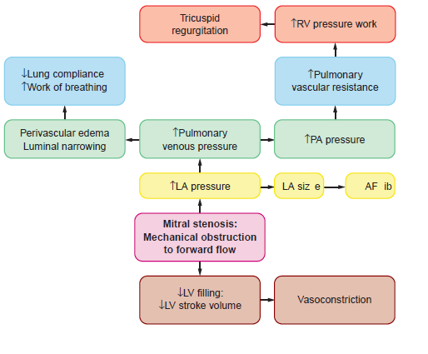
Cont…
Notes:
The increased left atrial pressure in patients with MS gradually produces left atrial dilation. Such atrial enlargement can lead to the onset of atrial fibrillation and also to thromboembolic complications if a clot forms in the atrium or appendage due to low velocity blood flow.

Slide 70
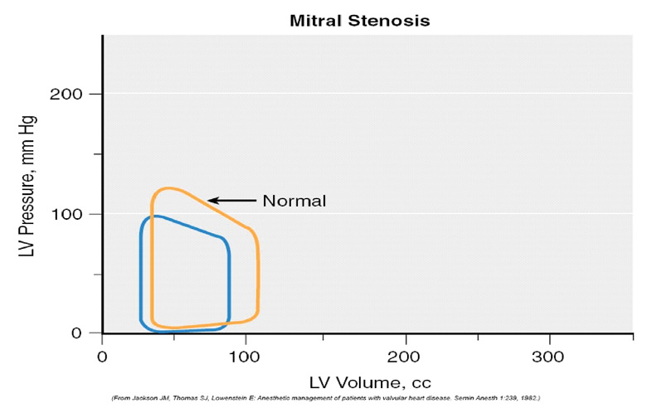
CONT…
Notes:
In cases of MS, pressure-volume loops are shifted to the left, so that LVEDP and LVEDV are lower

Slide 71
Signs and symptoms
90% of patients present with CHF and Atrial fibrillation
10-15% develop chest pain
Hoarseness caused by enlarged left atrium putting pressure on left recurrent laryngeal nerve
Pulmonary HTN from chronic increase in PVR
Hemoptysis

Slide 72
Cont…
Soft, grade I or II/VI middiastolic murmurs are commonly heard at the apex or along the left sternal border
Hepatomegaly, ankle edema, ascites, and pleural effusion,
Diagnostic modality
ECG/echocardiography
C-X ray and cardiac catheterization

Slide 73
Treatment
Anticoagulation
Sodium restriction
Diuretics
Valve replacement

Slide 74
Anesthesia management
Hemodianamic goal
HR- keep slow to allow for diastolic filling; avoid sinus tachycardia
Rhythm- sinus rhythm; if A-fib, control rate
Preload- Maintain or slightly
Afterload- SVR should be maintained; avoid decreases in SVR; avoid increases in PVR
Contractility- Maintain to provide adequate cardiac output
Notes:
Preload- Maintain or slightly increase to help with left ventricular filling; excess preload may cause pulmonary edema

Slide 75
Anesthesia consideration
Prevent rapid ventricular wall stress increases
Minimize increases in central blood volume
Avoid marked decreases in SVR
Prevent increase in PA pressure
Notes:
Phenylephrine is preferred over ephedrine. the avoidance of tachycardia, as the time required for left ventricular diastolic fi lling is prolonged in mitral . A high thrombo-embolic risk is associated with valvular AF. This is particularly pronounced in patients with severe MS. Prevention of pain, hypoxemia, hypercarbia and acidosis which may increase pulmonary valvular resistance

Slide 76
Cont….
Maintain sinus rhythm avoid tachycardia
Avoid increase in PVR and HR
Avoid large increase in CO both hypovolemia & fluid over load
induce in Trendelenberg position (Preexsting left atrial thrombus).
Notes:
If patient has preexisting left atrial thrombus, patient should be induced in Trendelenberg position to avoid the risk of thromboembolism and LV inflow obstruction.

Slide 77
Cont…
In patients with MS, oversedation in the preoperative period should be avoided to prevent hypoventilation.
Bleeding complications from chronic anticoagulation in patients with atrial fibrillation should be anticipated
Notes:
Epinephrine and milrinone are good therapeutic options. Newer therapeutic options for treatment of refractory pulmonary hypertension include inhaled prostacyclin or nitric oxide.

Slide 78
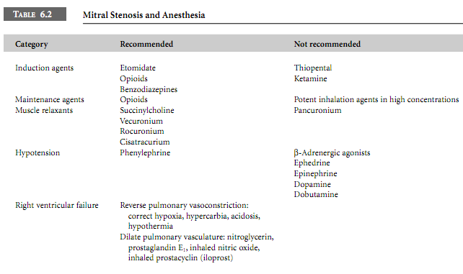
2007, J. Anaesth

Slide 79
Choice of anesthesia
GA VS RA
GA also provides very stable hemodynamic course, if the cardiovascular effects associated with laryngoscopy, intubation and oral suction are minimized.

Slide 80
Cont….
A beta-blocker such as esmolol and a modest dose of opioid should be administered before or during the induction of general anesthesia.
Modified rapid sequence intubation an ideal choice in severe stenosis with pulmonary hypertension.
Maintenance of anesthesia can be carried out with oxygen, isoflurane, opioids and vecuronium.

Slide 81
Mitral Regurtation
back flow of blood into LA during systole because of an incompetent valve. This leads to:
Increased left atrial pressure
Increased pulmonary artery pressure
Pulmonary edema/HTN
Left ventricular hypertrophy occurs due to the increased workload required to maintain volume output
Notes:
but the atrium usually does not enlarge

Slide 82
Etiology
Acute
Endocarditis
Papillary muscle rupture (post-MI)
Trauma
Chordal rupture/leaflet flail (MVP, IE)
Chronic
Myxomatous (MVP)
Rheumatic fever
Endocarditis (healed)
Mitral annular calcification
Congenital (cleft, AV canal)
HOCM with SAM
Ischemic (LV remodeling)
Dilated cardiomyopathy

Slide 83
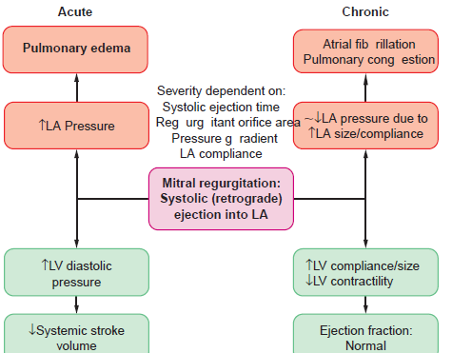
PATHOPHYSIOLOGY

Slide 84
Cont….
The fraction of left ventricular stroke volume that regurgitates into the left atrium depends on
the size of the mitral valve orifice
heart rate- determines the duration of ventricular ejection
pressure gradients across the mitral valve

Slide 85
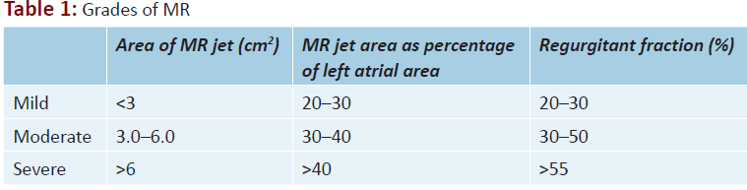
Cont….

Slide 86
Signs and symptoms MR
Degree of atrial compliance will determine the clinical manifestations.
Patients with chronic mild-to-moderate, isolated MR are usually asymptomatic.
Notes:
Patients with chronic mild-to-moderate, isolated MR are usuallyasymptomatic. This form of LV volume overload is well tolerated

Slide 87
Cont….
Normal or reduced atrial compliance (acute MR) will result in pulmonary vascular congestion and edema
Increased atrial compliance (chronic MR) will demonstrate signs of decreased cardiac output

Slide 88
Cont…
Fatigue, exertional dyspnea, and orthopnea are the most prominent complaints in patients with chronic severe MR.
Blowing pansystolic murmur” best heard at the cardiac apex and often radiating to left axilla
Notes:
Right-sided heart failure, with
painful hepatic congestion, ankle edema, distended neck veins, ascites,
and secondary TR, occurs in patients with MR who have associated
pulmonary vascular disease and pulmonary hypertension

Slide 89
Cont…
Palpitations are common and may signify the onset of AF.
Right-sided heart failure
Diagnostic modality –ECG/Echo, C-x- ray

Slide 90
TREATMENT
Medical therapy
Warfarin should be provided once AF intervenes with a target INR of 2–3.
Cardioversion should be considered depending on the clinical context and LA size.
Stabilization of heart failure

Slide 91
Cont…
Patients with acute severe MR require urgent stabilization and preparation for surgery
Surgical treatment –trans catheter mitral valve repair

Slide 92
Anesthesia consideration of MR
Selection of anesthetics that promote vasodilation and tachycardia
In chronic MR, vasoactive medications are usually not necessary because of LV compensatory mechanisms.
Notes:
In the absence of acute deterioration, pharmacologic intervention is not needed usually until the postbypass period.

Slide 93
Cont….
However, patients with acute MR may need aggressive pharmacologic management.
However, vasodilators and inotropes may lead to reoccurrence or worsening of MR.

Slide 94
Anesthesia management
HR- maintain or increase; (80-100 ideal)
Rhythm- sinus rhythm
Preload- Maintain or slightly increase
Afterload- Decrease to improve forward cardiac output; avoid sudden increases in SVR
Contractility- Maintain or increase to decrease left ventricular volume
Notes:
Preload- Maintain or slightly increase; an elevated preload will cause an increase in regurgitant flow, and low preload causes inadequate cardiac output

Slide 95
Cont….
Take care of IV FLUIDS
excess fluids will dilate the LV and worsen regurgitation
Need adequate volume to maintain forward SV
Minimize drug-induced myocardial depression
Give prophylactic antibiotics

Slide 96
Choice of anesthesia
Spinal and Epidural is tolerable
(avoid bradycardia)
In contrast to patients with mitral stenosis, patients with mitral regurgitation may benefit from the chronotropic effect of ephedrine if vasopressor is required.
Notes:
Spinal and epidural are well tolerated (avoid bradycardia)

Slide 97
Cont…
If GA is required, ketamine and pancuronium are desirable agents in these patients.
BP monitoring and pulmonary artery catheter monitoring are advisable.

Slide 98
Summary
Management in perioperative period require understanding of hemodynamic alteration that accompanies dysfunction of cardiac valve.
RA provides the least amount of alteration in hemodynamics, although GA equally safe when the abrupt changes associated with laryngoscopy, intubation, and extubation are blunted by the appropriate choice of pharmacological agents and anesthetic techniques

Slide 99
Cont…
Pos.op.Every cardiac pts. Should on100% 02 supplement ,get adequate ant pain ,
15-30 degree head up position.
Fluid balance should be adjusted for the particular disorder.
Ideally normovolaemia should be achieved

Slide 100


